Slide 1
How?
Organisational
transformation
Coherency at all levels &
Pilots with opt-outs
Cultural
transformation
Acts to fill in the Trust bucket
Personal
transformation
Authentic posture
change of top managers

Slide 2
10%
engaged
70%
not-engaged
20%
actively disengaged
Gallup 2017

Slide 3
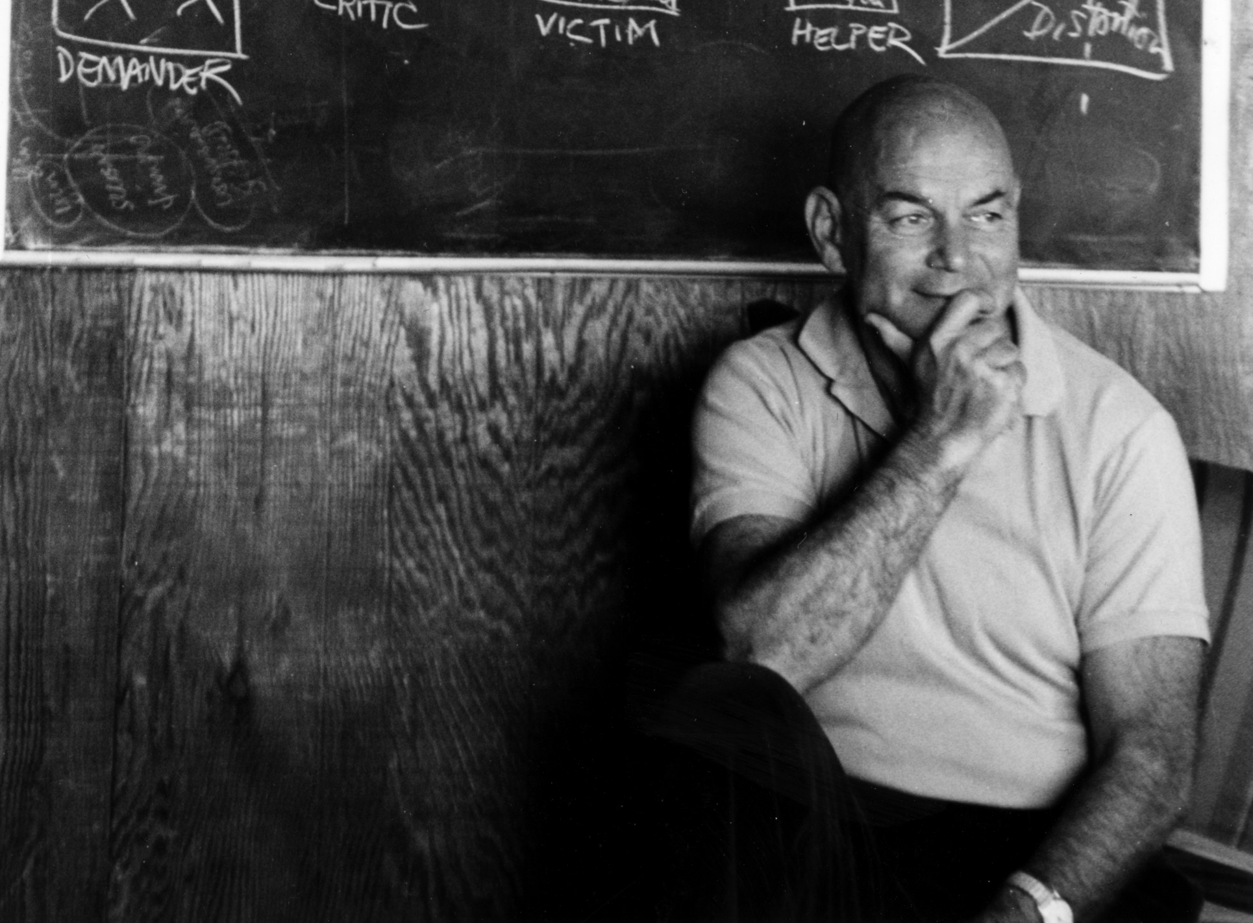
Will Schutz
The Human Element (1994)
Self-concept
is the key to solving organizational problems
If we want to improve team performance,
we must work on individuals

Slide 4
Self-esteem,well-being at work & teamwork requires to adress individuals’ fears of being…
Inclusion (respect)
Ignored
1
Control (self-direction)
Humiliated
2
Openness (Growth)
Rejected
3

Slide 5
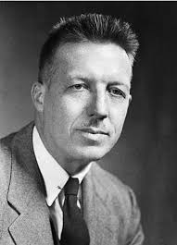
X & Y
Theories
Douglas Mc Gregor
The Human Side of Enterprise (1957)

Slide 6
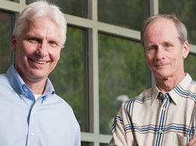
Self-determination theory of Deci & Ryan (1985)
Synthetized by Pr. Jacques Forest (UQAM)
Universal psychological needs
Motivation
Types
Physio- & psychological health correlations
Levers
Satisfaction
Autonomous Motivation
COUNTRY
AFFILIATION
GROWTH
AUTONOMY
PLEASURE
(intrinsic)
ENERGY
CONCENTRATION
HIGH PERFORMANCE
EXTRA’S HIGH PERF.
ADAPTIVE
ORGANISATION
DEPARTMENT
SUPERIORS
MEANING
(identified)
RELATIONS
WORK
Frustration
Controled Motivation
COUNTRY
AFFILIATION
GROWTH
AUTONOMY
PRIDE
(introjected)
BURNOUT
DISTRACTION
LOW PERFORMANCE
ANTISOCIAL COMP.
NON-ADAPTIVE
ORGANISATION
DEPARTMENT
SUPERIORS
RELATIONS
INCENTIVES
(extrinsic)
WORK
Amotivation

Slide 7
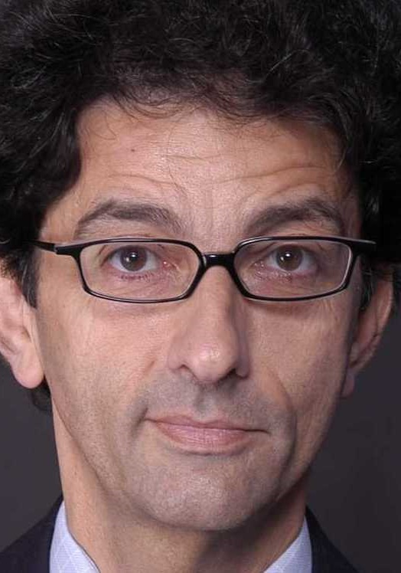
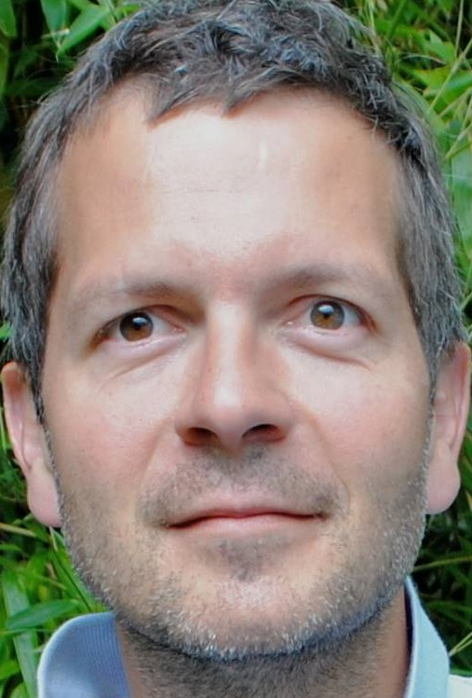
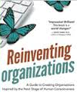
Getz
Laloux
Growth
towards wholeness &
evolutionary purpose
Affiliation
at all levels & between them, trust & respect for intrinsic equality & wholeness
Self-direction
within boundaries & rules defined in common & respected strictly

